Slide 1
Signals and Systems
Lecturer:
Dr. Bin Xia
Dept. of Electronic Engineering
Shanghai Jiao Tong University
Chapter 3: Fourier Series Representation of Periodic Signals

Slide 2
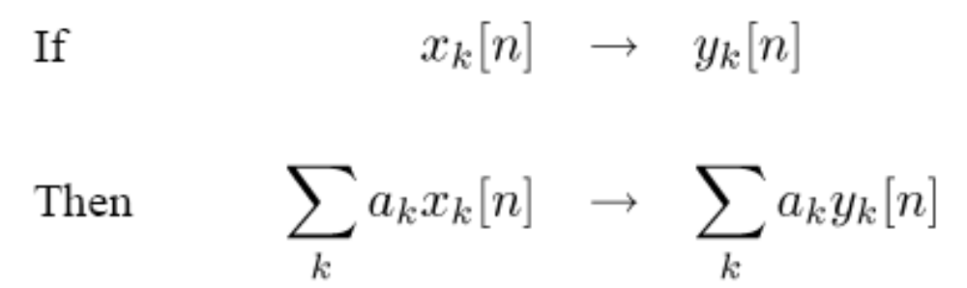
Foreword of the Chapter
By exploiting the properties of superposition and time invariance, if we know the response of an LTI system to some inputs, we actually know the response to many inputs
If we can find sets of “basic” signals so that
  We can represent rich classes of signals as linear combinations of these building block signals.
  The response of LTI Systems to these basic signals are both simple and insightful.

Slide 3



Candidate sets of basic signal
  Unit impulse function and its delays
  Complex exponential signals (Eigenfunctions of all LTI systems)
In this Chapter, we will focus on: why, how, what
  How to describe periodic signals representations in terms of Fourier series
  Properties of Fourier series of CT/DT periodic signals
  Fourier series and LTI systems
  In next two chapters we will investigate how to describe aperiodic signals in terms of the combinations of complex exponential signals and its related properties

Slide 4
Outline of the Chapter
3.1 Response of LTI Systems to Complex Exponential Signals
3.2 Fourier Series Representation of CT Periodic Signals
3.3 Convergence of Fourier series
3.4 Properties of CT Fourier Series
3.5 Fourier Series Representation of DT Periodic Signals
  3.6 Fourier series and LTI systems

Slide 5
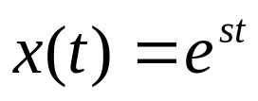
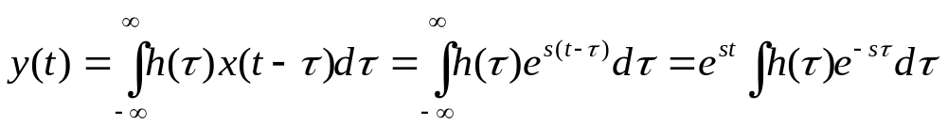
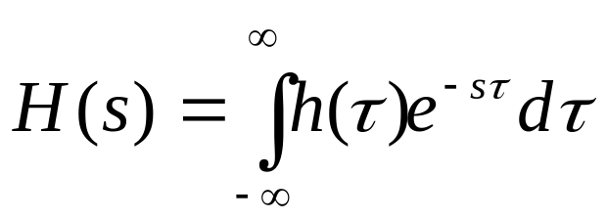
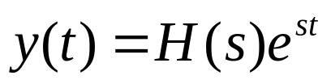
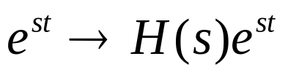
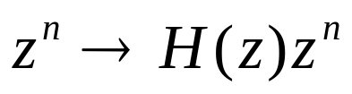
Let
——System function, assuming it is converged
then
The response to complex exponential of the LTI system:
the complex exponential with the same frequency, but scaled with H(s)
Similarly, for DT systems, one obtains

Slide 6

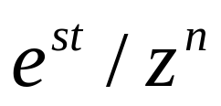

eigenvalue eigenfunction
Eigenfunction in →same function out with a “gain”
——eigenfunction (特征函数)
——eigenvalue (特征值)
Eigenfunction Property: The response of a LTI system to a complex exponential is a complex exponential with the same frequency, but scaled with H(s)/H(z) for CT and DT systems, respectively

Slide 7
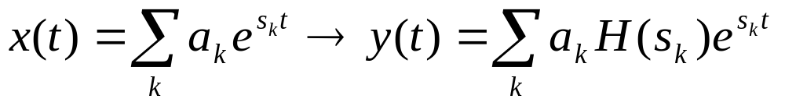
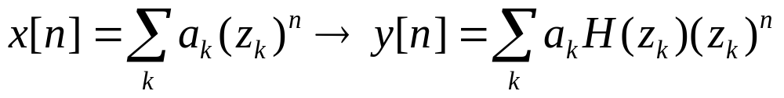
Following Eigenfunction property and superposition property of LTI systems, one obtains:
If the input to an LTI system is represented as a linear combination of complex exponentials, the output will be the linear combination of complex exponentials, each part is weighted by H(s_{k})/H(z_{k}), i.e. the weighted value is depending on the frequency response associated with of the exponential component (s_{k}/z_{k}) .

Slide 8
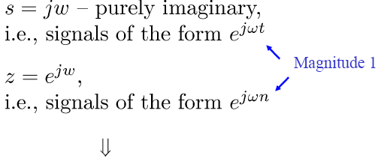

Q#1: How to represent singals as “sums” of complex exponentials
Q#2: What kinds of signals can we represent as “sums” of complex exponentials?
For Now: Focus on restricted sets of complex exponentials
CT:
DT:
s = jw – purely imaginaly,
i.e., signals of the form e^{jwt}
Magnitude 1
Z = e^{jΩ}
i.e., signals of the form e^{j Ωn}
CT & DT Fourier Series and Transforms
Periodic Signals

Slide 9
Outline of the Chapter
3.1 Response of LTI Systems to Complex Exponential Signals
3.2 Fourier Series Representation of CT Periodic Signals
3.3 Convergence of Fourier series
3.4 Properties of CT Fourier Series
3.5 Fourier Series Representation of DT Periodic Signals
  3.6 Fourier series and LTI systems

Slide 10

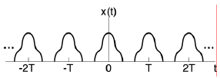

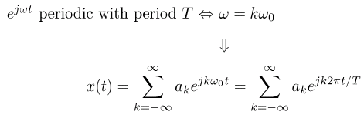
Fourier Series Representation of CT Periodic Signals
smallest such T is the fundamental period
is the fundamental frequency
Periodic with period T
-periodic with period T
-{a_{k}} are the Fourier (series) coefficients
-k= 0 DC
-k= 1 first harmonic （一次谐波）
-k= 2 2nd harmonic （二次谐波）

Slide 11

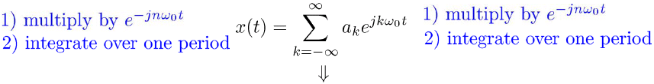
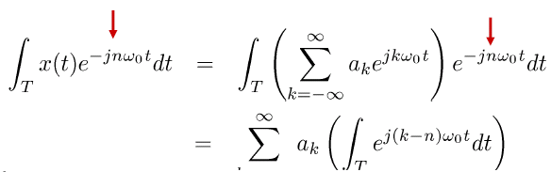
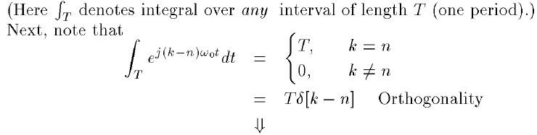
Question #1: How do we find the Fourier coefficients?
multiply by
multiply by
Integrate over one period
Integrate over one period
Here
denotes integral over any interval of length
Next, note that
Orthogonality

Slide 12
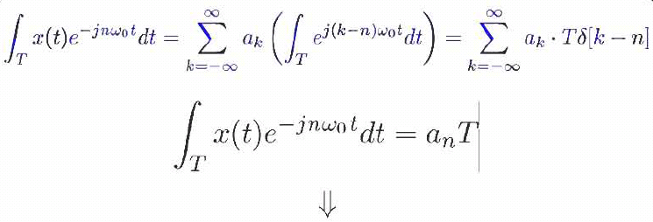
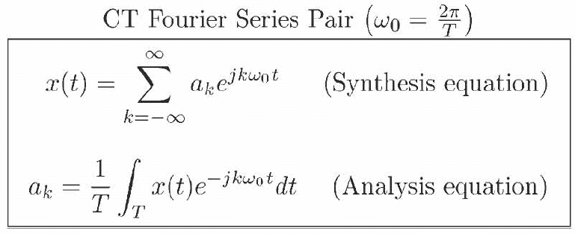
CT Fourier Series Pair
(Synthesis equation)
(Analysis equation)

Slide 13
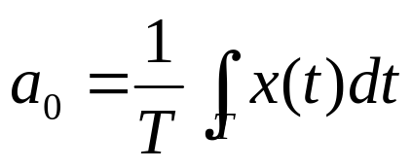
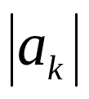

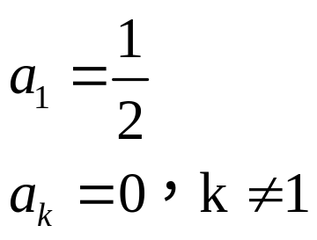

Fourier Series Representation of CT Periodic Signals:
The periodic signal x(t) could be constructed as a linear combination of the harmonically related complex exponentials (sinusoidal signals)
a_{k} is represents the magnitude and phase of k^{th} harmonic component
{a_{k}} are called as Fourier series coefficients, or spectrum of x(t)
{ | a_{k} |} -- magnitude spectrum, {arg(a_{k})} --phase spectrum
—constant component or DC component of x(t)
example：
1
1
1

Slide 14

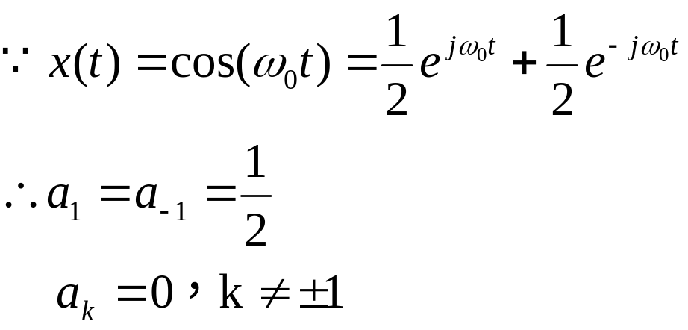

Magnitude Spectrum
Example:
1/2
-1
1
Spectrum of x(t): Magnitude Spectrum, Phase Spectrum
How about：

Slide 15
Observations:
1. The spectrum of the periodic signal x(t) is discrete, it has non-zero values only at kω₀, i.e. the spectrum space ω₀ is 2π/T
2. a_{k} is complex representing the magnitude and phase of k^{th} harmonic component
Notes: The negative frequencies (k<0) are meaningless in real world, they are for mathematical representations and derivations.

Slide 16
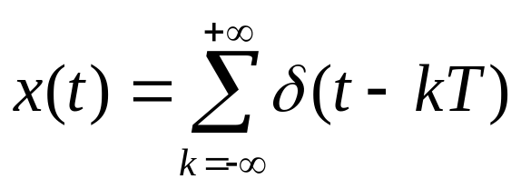
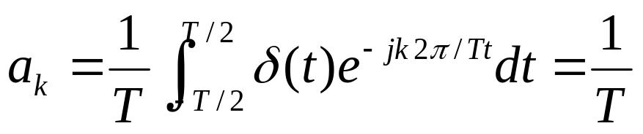
Example:
x(t)
…
…
-T
T
2T
t
a_{k}
…
…
-1
1
2
k

Slide 17
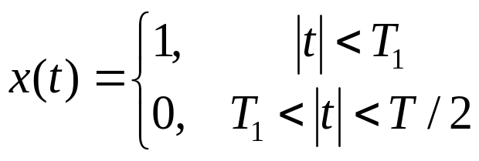



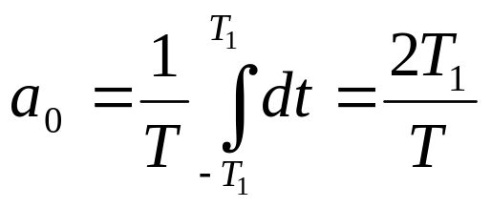

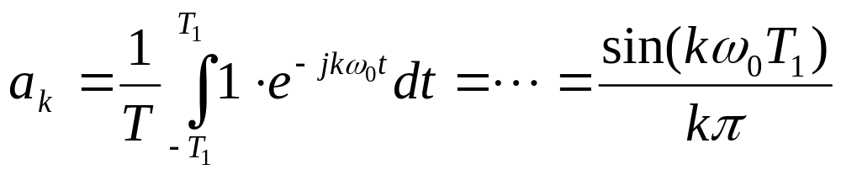

x(t)
Ex: Periodic Square Wave
t
——DC

Slide 18
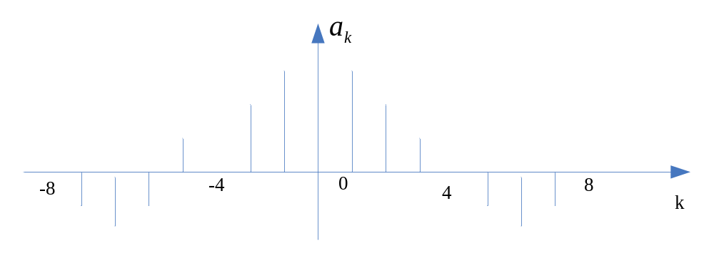
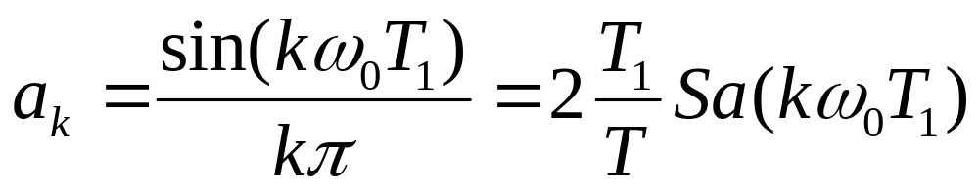
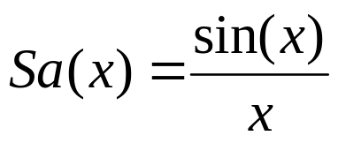
The envelop is the sampling function
for T=8T₁
F.C. of the periodic square wave with fundamental frequency of T and pulse width of 2T₁:
where the sampling function is defined as
The first zero value of the F.C. of the periodic square wave with fundamental frequency of T and pulse width of 2T₁ is at the k^{th} point satisfying kω₀T₁ =π, i.e. the main lobe of the signal is T/(2T₁) (Hz), i.e. the bandwidth of the signal

Slide 19
Outline of the Chapter
3.1 Response of LTI Systems to Complex Exponential Signals
3.2 Fourier Series Representation of CT Periodic Signals
3.3 Convergence of Fourier series
3.4 Properties of CT Fourier Series
3.5 Fourier Series Representation of DT Periodic Signals
  3.6 Fourier series and LTI systems

Slide 20

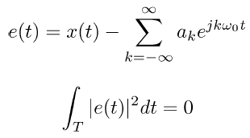

Convergence of CT Fourier Series
• The key is: What do we mean by
• One useful notion for engineers: there is no energy in the difference
(just need x(t) to have finite energy per period)

Slide 21

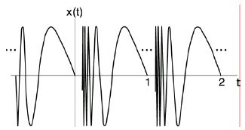

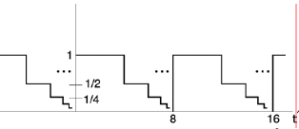
Under a different, but reasonable set of conditions (the Dirichlet conditions)
Condition 1. x(t) is absolutely integrable over one period, i. e.
And
Condition 2. In a finite time interval, x(t) has a finite number
of maxima and minima.
Ex. An example that violates Condition 2.
And
Condition 3. In a finite time interval, x(t) has only a finite number of discontinuities.
Ex. An example that violates
Condition 3.

Slide 22
Signals do not satisfy the Dirichlet conditions are generally pathological in nature, and do not typically exist in real world.
Dirichlet conditions are met for the signals we will
encounter in the real world. Then
- The Fourier series = x(t) at points where x(t) is continuous
- The Fourier series = “midpoint” at points of discontinuity
- There has no energy difference between the original signal and its Fourier series representation
- Since the original signal and its Fourier series representation only differ at isolated points, the integral of both signals over any interval are identical, i.e. the two signals behave identically under convolution, and during the analysis of LTI systems.

Slide 23

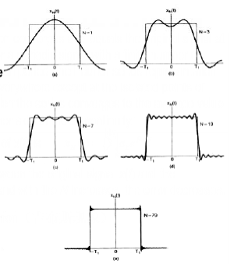
• Still, convergence has some interesting characteristics:
There exists error between the original signal x(t) and the approximation x_{N}(t), it decreases as N increases
As N→ ∞, x_{N}(t) exhibits Gibbs’ phenomenon at points of discontinuity (1.09)

Slide 24
Outline of the Chapter
3.1 Response of LTI Systems to Complex Exponential Signals
3.2 Fourier Series Representation of CT Periodic Signals
3.3 Convergence of Fourier series
3.4 Properties of CT Fourier Series
3.5 Fourier Series Representation of DT Periodic Signals
  3.6 Fourier series and LTI systems

Slide 25
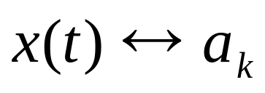
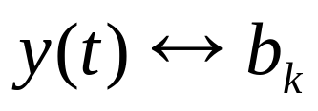
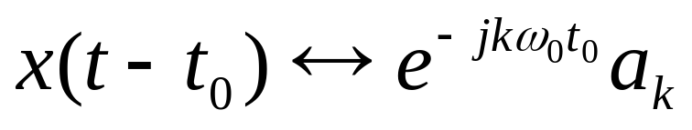
  Linearity
Time Shifting
Time shifting introduces a linear phase shift ∝t₀ in frequency domain
W6.1

Slide 26
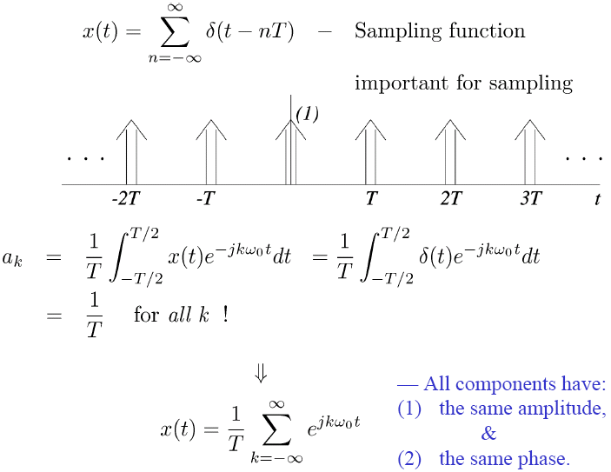
Example: Periodic Impulse Train

Slide 27
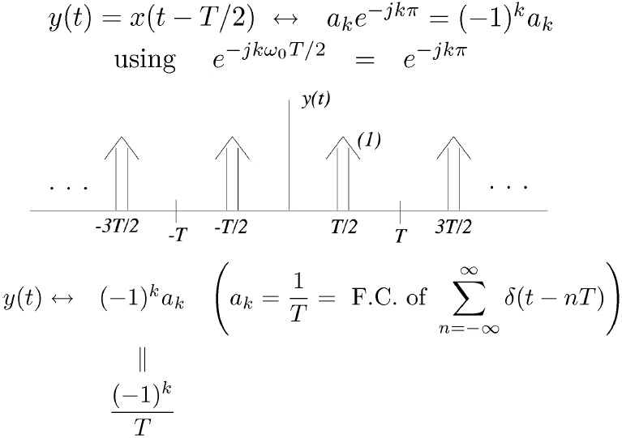
Example: Shift by half period
using

Slide 28
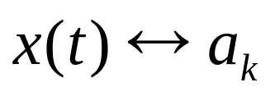
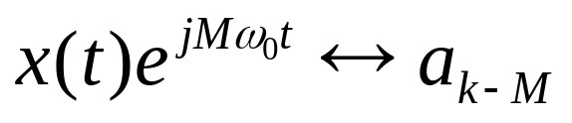
Freuency Shifting
Eg. Carrier Modulation

Slide 29
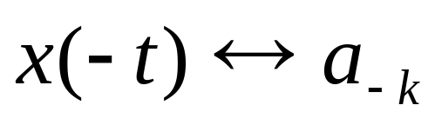
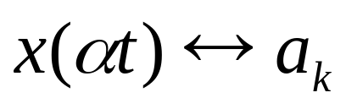
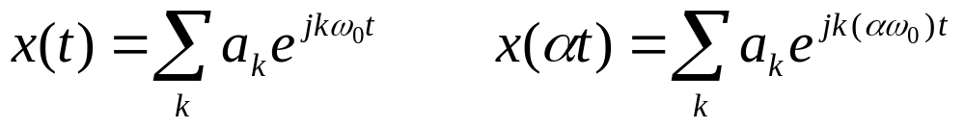
Time Reversal
Compression of a signal in time domain results in spectrum expand
Time Scaling
Although the F.C. of x(at) and x(t) are identical, they have different fundamental frequency

Slide 30
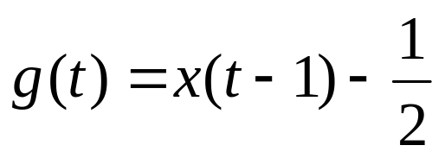
Example 3.6,p206
g(t)
1/2
-2
-1
1
2
t
-1/2
x(t)
-2
-1
1
2
3
4
5
t

Slide 31
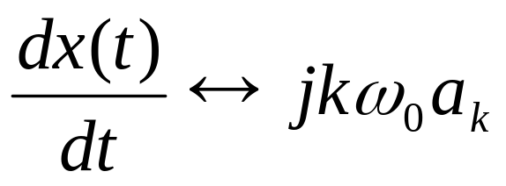
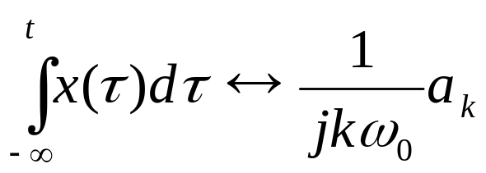
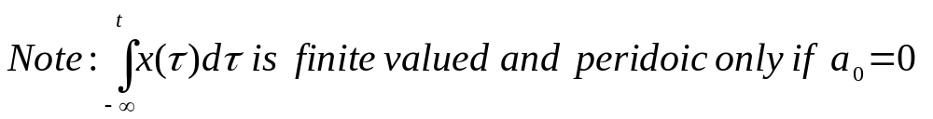
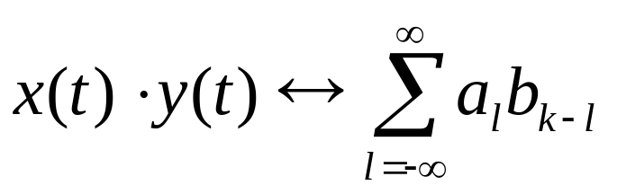
Differential Integral
Multiplication
Notes:
利用综合公式来推导

Slide 32
Example:
x(t)
2
-6
-2
0
2
4
6
8
t
x’(t)
1
-2
2
t
x”(t)
-2
2
t

Slide 33
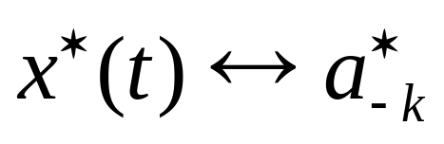


Conjugation and Conjugate Symmetry
If x(t) is real
--Conjugate Symmetry

Slide 34



Slide 35



Parseval’s Relation
_average power in one period of x(t)
_average power in the kth harmonic component
Energy is the same whether measured in the time-domain or the frequency-domain

Slide 36
Outline of the Chapter
3.1 Response of LTI Systems to Complex Exponential Signals
3.2 Fourier Series Representation of CT Periodic Signals
3.3 Convergence of Fourier series
3.4 Properties of CT Fourier Series
3.5 Fourier Series Representation of DT Periodic Signals
  3.6 Fourier series and LTI systems

Slide 37


Fourier Series Representation of DT Periodic Signals
• x[n] -periodic with fundamental period N, fundamental frequency
• Only e ^{jωn} which are periodic with period N will appear in the FS
• There are only N distinct signals of this form
• So we could just use only N distinct exponential sequenceus to represent a DT periodic signal
• However, it is often useful to allow the choice of N consecutive values of k to be arbitrary.

Slide 38



DT Fourier Series Representation
= Sum over any N consecutive values of k
— This is a finite series
- Fourier (series) coefficients
Questions:
1) What DT periodic signals have such a representation?
2) How do we find a_{k}?

Slide 39

Answer to Question #1:
Any DT periodic signal has a Fourier series representation
N equations for N unknowns, a₀, a₁, …, a _{N-1}

Slide 40

A More Direct Way to Solve for a_{k}
Finite geometric series
otherwise

Slide 41


So, from
multiply both sides by
and then
orthoronality

Slide 42


DT Fourier Series Pair
(Synthesis equation)
(Analysis equation)
Note:It is convenient to think of a_{k} as being defined for all integers k. So:
1) a_{k+N}= a_{k} —Special property of DT Fourier Coefficients.
2) We only use N consecutive values of a_{k} in the synthesis equation. (Since x[n] is periodic, it is specified by N numbers, either in the time or frequency domain)
W6.2

Slide 43

Example #1: Sum of a pair of sinusoids
periodic with period

Slide 44

Example #2: DT Square Wave
multiple of
Using

Slide 45

Example #2: DT Square Wave (continued)

Slide 46

Convergence Issues for DT Fourier Series:
Not an issue, since all series are finite sums.
Properties of DT Fourier Series: Lots, just as with CT Fourier Series
Example:
Frequency shift

Slide 47
Outline of the Chapter
3.1 Response of LTI Systems to Complex Exponential Signals
3.2 Fourier Series Representation of CT Periodic Signals
3.3 Convergence of Fourier series
3.4 Properties of CT Fourier Series
3.5 Fourier Series Representation of DT Periodic Signals
3.6 Fourier series and LTI systems

Slide 48


The Eigenfunction Property of Complex Exponentials
CT:
CT
"System Function"
DT:
DT
"System Function"

Slide 49



Fourier Series: Periodic Signals and LTI Systems
So
or powers of signals get
modified through filter/system
Includes both amplitude & phase
Includes both amplitude & phase

Slide 50


The Frequency Response of an LTI System
The output of an LTI system to the periodic signal is also periodic with the same period, and the k^{th} F.C. of the output signal is the product of the k^{th} F.C. of the input and the value of the frequency response of the LTI system at the corresponding frequency or , for CT and DT systems, respectively.
In next two chapters, we will have more detailed and general discussions on frequency response of LTI systems to aperiodic CT/DT signals.

Slide 51


Example #1: Frequency Selective Filters
— Filter out signals outside of the frequency range of interest
Lowpass Filters
CT
  ω_{c} — cutoff
  frequency
Stopband
Passband
Stopband
DT
  Note: |H| = 1 and ∠H = 0 for the ideal filters in the passbands,
  no need for the phase plot.

Slide 52


Highpass Filters
CT
DT

Slide 53


Bandpass Filters
CT
lower cut-off upper cut-off
DT

Slide 54

Example #2: DT Averager/Smoother
FIR (Finite Impulse
Response) filters
LPF

Slide 55


Example #3: Nonrecursive DT (FIR) filters
Rolls off at lower ω as M+N+1 increases

Slide 56

Example #4: Simple DT “Edge” Detector
  — DT 2-point “differentiator”
Passes high-frequency components

Slide 57
Homework (Due W9-D2)
  BASIC PROBLEMS WITH ANSWER: 3.3, 3.4
  BASIC PROBLEMS: 3.22(a), 3.23

Slide 58
Summary
3.1 Response of LTI Systems to Complex Exponential Signals
3.2 Fourier Series Representation of CT Periodic Signals
3.3 Convergence of Fourier series
3.4 Properties of CT Fourier Series
3.5 Fourier Series Representation of DT Periodic Signals
3.6 Fourier series and LTI systems

